Slide 1
PROJECT
Kiran S
Aryamol A U
Nithin K Shoji
Sreedev D S

Slide 2

A Web Based Data Mining Framework for Generating User Profiles

Slide 3
ABSTRACT
We present a complete framework and findings in mining Web usage patterns from Web log files of a real Web site that has all the challenging aspects of real-life Web usage mining.
Even though the Web site under study is part of a non-profit organization that does not "sell" any products, it was crucial to understand "who" the users were, "what" they looked at, and "how their interests changed with time," all of which are important questions in Customer Relationship Management (CRM).
Hence, we present an approach for discovering and tracking evolving user profiles.

Slide 4
Existing Systems
The present system contains functionality to receive data as normal keywords

Slide 5
Hardware Requirements
1. Laptops, Pcs etc for accessing the system.
2. Working internet connection.

Slide 6



Software Requirements
1. OS for the system.
2. Web browser.
3.Software run time environments.
4.Apache server.

Slide 7


Languages Used
1. HTML
2. CSS
3. Java Script
4. Java

Slide 8



5. PHP
6. Python
7. Database

Slide 9

Libraries and Frameworks
1. Scrapy of python
2. D3.js of Java Script
3.Spark ML of apache

Slide 10

Requirements for Creation
1. Designing Web Crawler.
2. Database maintaining and Organising.
3. Mining required data.
4.Visualising with d3.js

Slide 11
Advantages
1. Faster access to data.
2.Well organisable and maintainable.
3.Safe and Secure.
4. Reliable.
5. All data concentrated at one place.
6.Donot require to open multiple tags.

Slide 12
Disadvantages
1. Chances of alterations due to spamming.
2. Duplicated names can cause problems.
3. Requires accurate names for mining.

Slide 13
Process Flow
Crawling and Mining
Database
Visualisation

Slide 14
MODULES USED
DATA INPUT MODULE
1.Data entry
The datas are entered into a text box that supports a certain character limit.
2.Voice recognition
This module handles voice data insertion.
They receive data input as voice or speech and enters in to the search bar

Slide 15
3.Data validation
Validates the data inserted into the search box.
Validating mail id's
Eg validates email format example@example.com
Validating mobile number
Eg Validates the usage of mobile phone numbers with respect to country standards
4.User identification
The module shows his/her ip address,date,time and location of access.

Slide 16
DATA PROCESSING MODULES
1.Web crawler
The web crawler module developed in python language serves as the backbone of the software.
The self designed crawler is able to crawl data from various places and store data as .csv files.
2.Data mining
The data mining module extracts data and makes it ready for visualization.

Slide 17
3.Data visualisation
This module tend to display data information's that are mined into a user profile
The visualization include more features rather than normal profile view.
4.Trends visualizing
The module visualized by graphs and charts are of greater functionality.
They provide the graphs on frequency of searches and profile ratings.

Slide 18
5.Profile sharing
The users can share the generated profile by means of mails or in social networks.
They can do this by login in by using there user id's and passwords.
6.Data cache
The data cache module is a special feature implemented which handles live cache.
The software can hold the searched data's for a specific period of time (may be 7 days or more as specified).

Slide 19
DETAILED FUNCTION FLOW
User input
Data identification
User input
Data crawler
.csv file creation
Data storage in DB
no
If data exist
Data mining
yes
Visualistion
Update content

Slide 20
DATABASE DESIGNS
1.Data table
The table store data by the crawled data.
2.Trends table
Stores data on most searched items.
3.News table
Stores data on latest searches in the world.

Slide 21
UML DIAGRAMS

Slide 22

USE CASE DIAGRAM
Search
View results
Search using a particular entity
Rate profiles
Users
Admin
Share profile
Configure features

Slide 23
SEQUENCE DIAGRAM
Users
Server
Web sites
Local DB
Search
Crawl
Store
Result set
Visualization

Slide 24
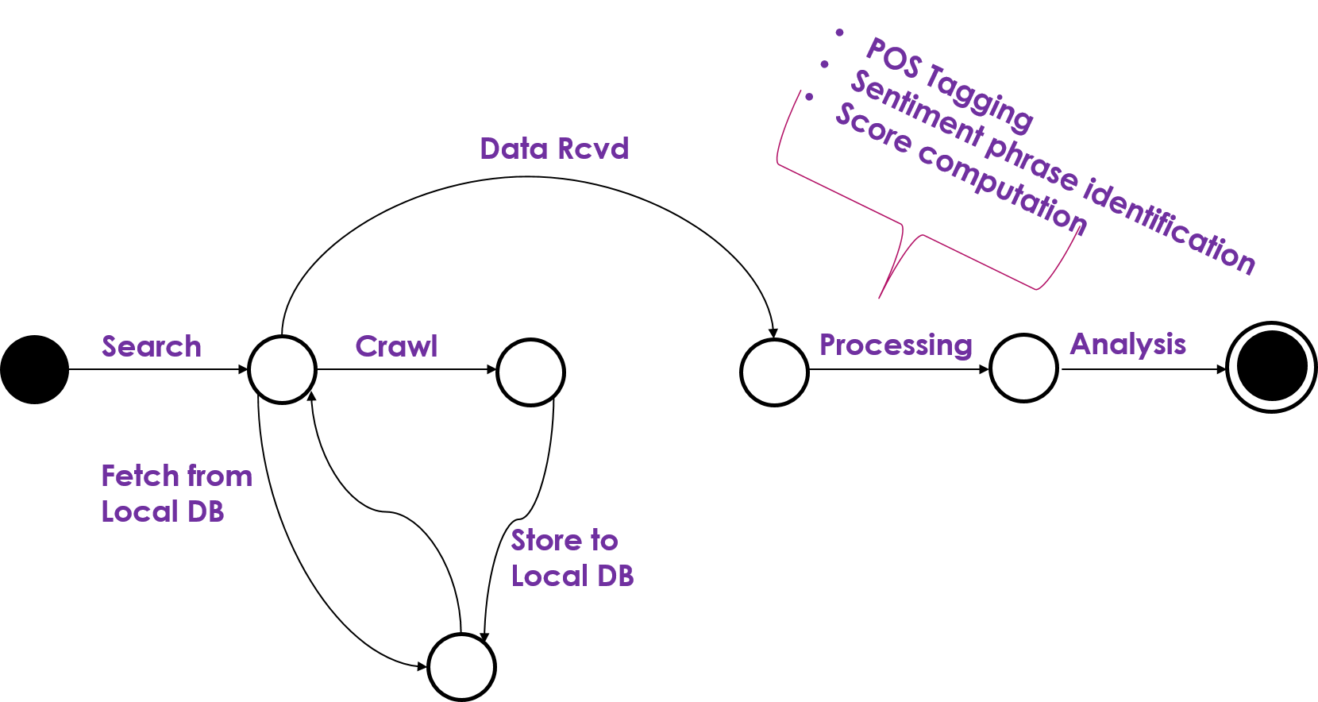
STATE DIAGRAM

Slide 25
ACTIVITY DIAGRAM

Slide 26
user
.csv file creation
User input
Data mining
Check in cache
Data storage in db
no
If data exist
no
Data identify
yes
yes
Data crawling
Update content
visualization

Slide 27
EXTRA FUNCTIONALITIES
The extra functions included are
1.Live cache data storage
2.Shows ip address, date and time of using machine.
3.Shows search rankings
4.Displays latest trending searches in the world

Slide 28
Conclusion
Creating a fast and reliable way for mining data and generating user profiles.

Slide 29
Thank you

